Slide 1
Spiritual Gifts 2: Power Up the Body
25 May 2019

Slide 2
What is a Spiritual Gift?
A special attribute given by the Holy Spirit to every member of the Body of Christ, according to God’s grace, for use within the context of the body.

Slide 3
Galatians 5:22-23
²² By contrast, the fruit of the Spirit is love, joy, peace, patience, kindness, generosity, faithfulness, ²³ gentleness, and self-control. There is no law against such things.

Slide 4
Galatians 5:25
²⁵ If we live by the Spirit, let us also be guided by the Spirit.

Slide 5
Four Actions to Discover God’s Calling:
Give thanks to God for creating, equipping, and guiding you in the unique way that makes you who you are.
Ask God to help you grow in the Fruit of the Spirit (Galatians 5:22-23) & practice them
Ask God to guide you as you discover your spiritual gifts
Ask God how you might best serve to advance the work of God.

Slide 6
Three New Testament Passages:
Romans 12
1 Corinthians 12
Ephesians 4
12 – 12 – 12 (Eph. 4 x 3 NT passages)

Slide 7
Administration (1 Cor. 12:28)
The ability to understand what makes an organization function
Develop strategies to reach goals, organize people, tasks, and events
Help ministries become more effective and efficient

Slide 8
Apostleship (1 Cor. 12:28; Eph. 4:11)
The ability to start and oversee the development of new churches or ministries
Desire to minister to unchurched people
Take responsibility to oversee new ministries or churches

Slide 9
Crafting/Craftsmanship (Ex. 35:30-33)
The divine enablement to creatively design or construct items to be used for ministry
Serve with their hands to meet needs of ministries
Skilled in working with different raw materials
Can be traditional materials (wood, cloth, glass) or computer/internet assets!

Slide 10
Creative Communication (Psalms)
The ability to communicate God’s truth through a variety of art forms
Develop and use artistic skills (drama, writing, music)
Use variety and creativity to captivate people, challenge perspectives of God through different forms of the arts

Slide 11
Discernment (1 Cor. 12:10)
The ability to distinguish between truth and error, or good/evil spirits
Have special sensitivity to truth vs. error, right vs. wrong, pure motives or impure

Slide 12
Encouragement (Rom. 12:8)
The ability to strengthen, comfort, and encourage those who are discouraged or wavering in faith
Emphasize God’s promises
Motivate others to grow
Hope in the promises of God

Slide 13
Evangelism (Eph. 4:11)
The ability to effectively communicate the gospel to unbelievers so they respond in faith
Seek out opportunities to talk or build relationships with unbelievers
Communicate the gospel with clarity and conviction, leading to a decision for Christ

Slide 14
Faith (1 Cor. 12:9)
The ability to act on God’s promises with confidence and unwavering belief
Believe the promises of God
Inspire others to believe
Trust God to overcome all obstacles

Slide 15
Giving (Rom. 12:8)
The ability to contribute money and resources to the work of the Lord with cheerfulness
Often, blessed with the ability to make and manage money to further God’s work
Contribute without need for glory or recognition

Slide 16
Helps (1 Cor. 12:28)
The ability to accomplish practical and necessary tasks which meet the needs of the church or others
Serve behind the scenes to support the gifts and ministries of others
Attach spiritual value to practical service

Slide 17
Hospitality (1 Peter 4:9-11)
The ability to care for people by providing fellowship, food, and shelter
Meet and greet new people
Help people feel welcomed
Create a safe space where people feel valued and cared for

Slide 18
Intercession (James 5:15)
The ability to pray on behalf of others, often seeing specific results
Feel compelled to pray on behalf of others or a cause
Convinced that God moves in response to prayer
Pray according to the leading of the Spirit—whether or not they understand it

Slide 19
Knowledge (1 Cor. 12:8)
The ability to bring truth through biblical insight
Search the Scriptures to discover Bible truth
Use their unusual capacities for understanding and insight to support the church

Slide 20
Leadership (Rom. 12:8)
The ability to create a vision, motivate, and direct people to accomplish God’s purposes
Take responsibility
Establish goals
Motivate others to do their best
Keep an eye on “big picture” values of the ministry

Slide 21
Mercy (Rom. 12:8)
The ability to practically help those who are suffering and in need
Serve in difficult circumstances cheerfully
Seek to alleviate suffering, both individual and social/systemic injustice (Racism, sexism, discrimination, poverty)

Slide 22
Prophecy (Rom 12:6, Eph. 4:11)
The divine ability to reveal truth and proclaim it in a timely and relevant manner
Speak the words of God producing conviction, repentance, and reconciliation
Strong perception of truth and understanding of God’s heart

Slide 23
Pastoring (Eph. 4:11)
The ability to nurture and guide people toward spiritual maturity
Lead and protect those in their care
Provide guidance
Model their lives in accordance with Jesus’ leading

Slide 24
Teaching (Rom 12:7; 1 Cor. 12:28; Eph. 4:11)
The ability to understand, clearly explain, and apply God’s words to produce Christ-likeness
Communicate Bible truth
Inspire greater obedience to God’s word
Challenge listeners with depth and practicality of Scripture

Slide 25
Wisdom (1 Cor. 12:8)
The ability to apply spiritual truth effectively to meet a need in a specific situation
Attuned to the Holy Spirit’s direction, even in difficult circumstances
Anticipate unintended consequences of decisions
Apply truth in specific and practical ways

Slide 26
Personality “Types”
Not the same as spiritual gifts, but usually related
Gifts tend to follow personality
Party animal or alone time? Lists and schedules or “wing it”? Cool logic or gut feelings?

Slide 27
Ways of Describing Personality
Four Temperaments: Sanguine/Choleric/Melancholy/Phlegmatic
Jungian Types/Myers-Briggs (Introvert-Extravert, Sensing-Intuition, Thinking-Feeling, Judgment-Perception)
“Big Five”
Enneagram (Numbers 1-9)

Slide 28
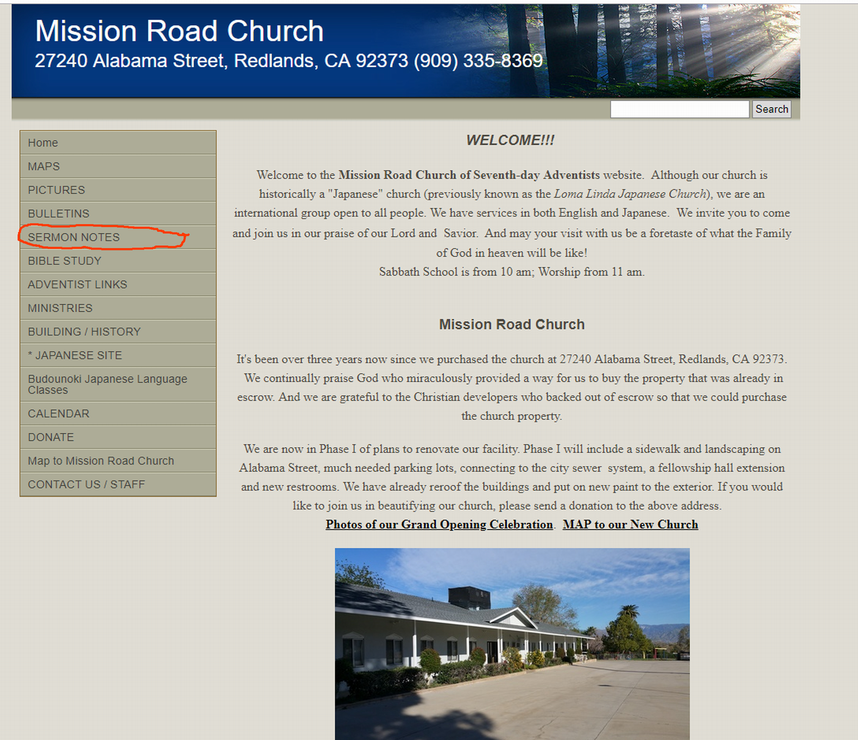

Slide 29
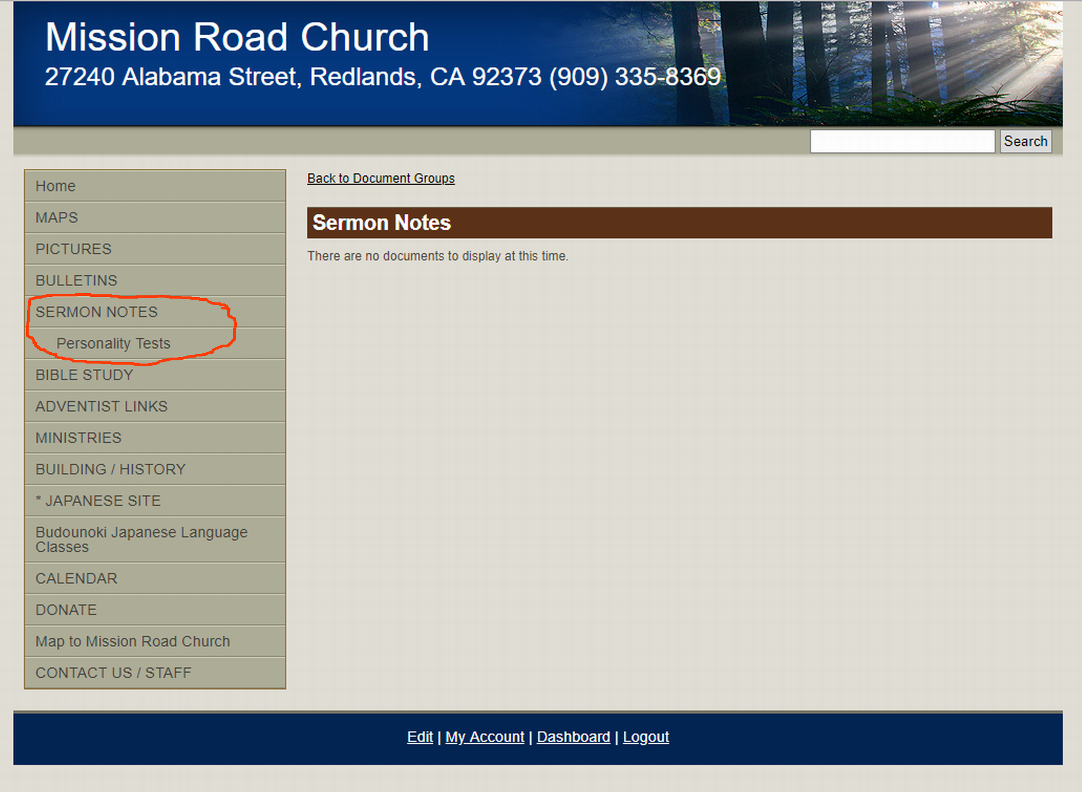

Slide 30
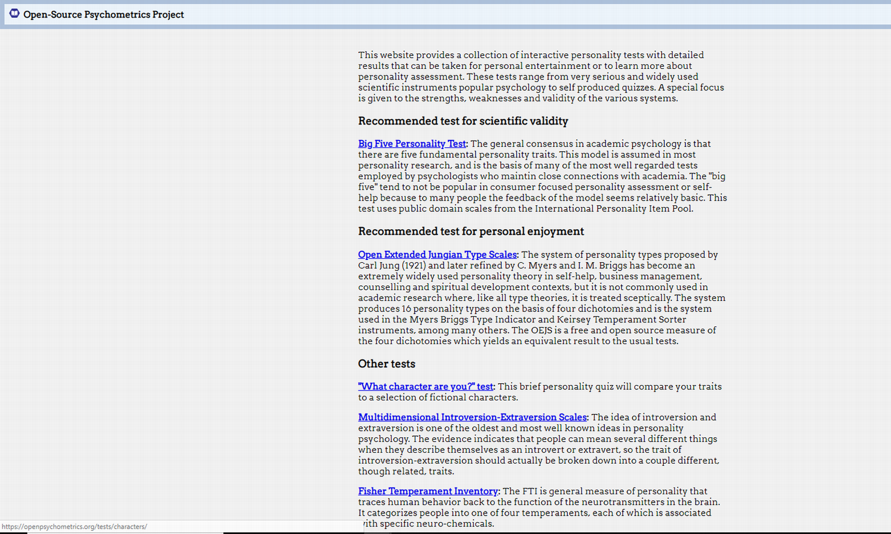

Slide 31
My Results on Personality Tests:
Four Temperaments: Phlegmatic/Melancholy
Myers-Briggs: INFP (Introversion, Intuition, Feeling, Perception)
Enneagram: 9, wing 1

Slide 32
4 Steps to Determine Our Spiritual Gifts
Note: This is an ongoing journey, not “4 Simple Steps to…”

Slide 33
Step 1: Be Open to Possibilities
Think about how God created you to serve the church
Study the Bible, especially Spiritual Gifts chapters (Rom. 12, 1 Cor. 12, Eph. 4)
Pray for guidance
Get to know people you perceive to be gifted

Slide 34
Step 2: Examine Your Feelings
Read over the list of Spiritual Gifts
Which ones catch your interest?
Matt. 7:11 “…How much more will your Father in heaven give good things to those who ask!”
Ministry should be fulfilling and overall enjoyable (even if some parts are difficult)

Slide 35
Step 3: Experiment with Gifts
Take a look at the church: What do you perceive as needs?
How has God placed you to meet these needs?
Contact an elder or pastor with your ideas
Take a Spiritual Gifts Inventory

Slide 36
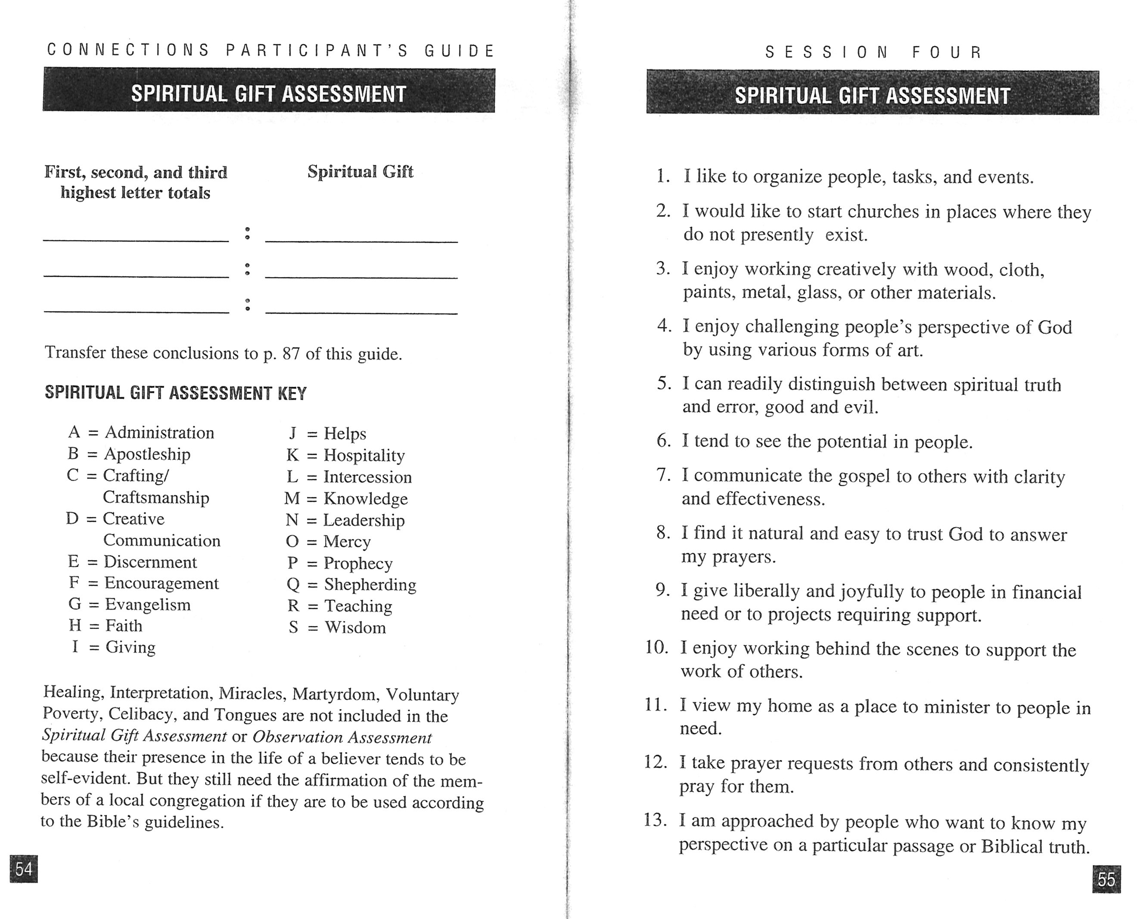

Slide 37
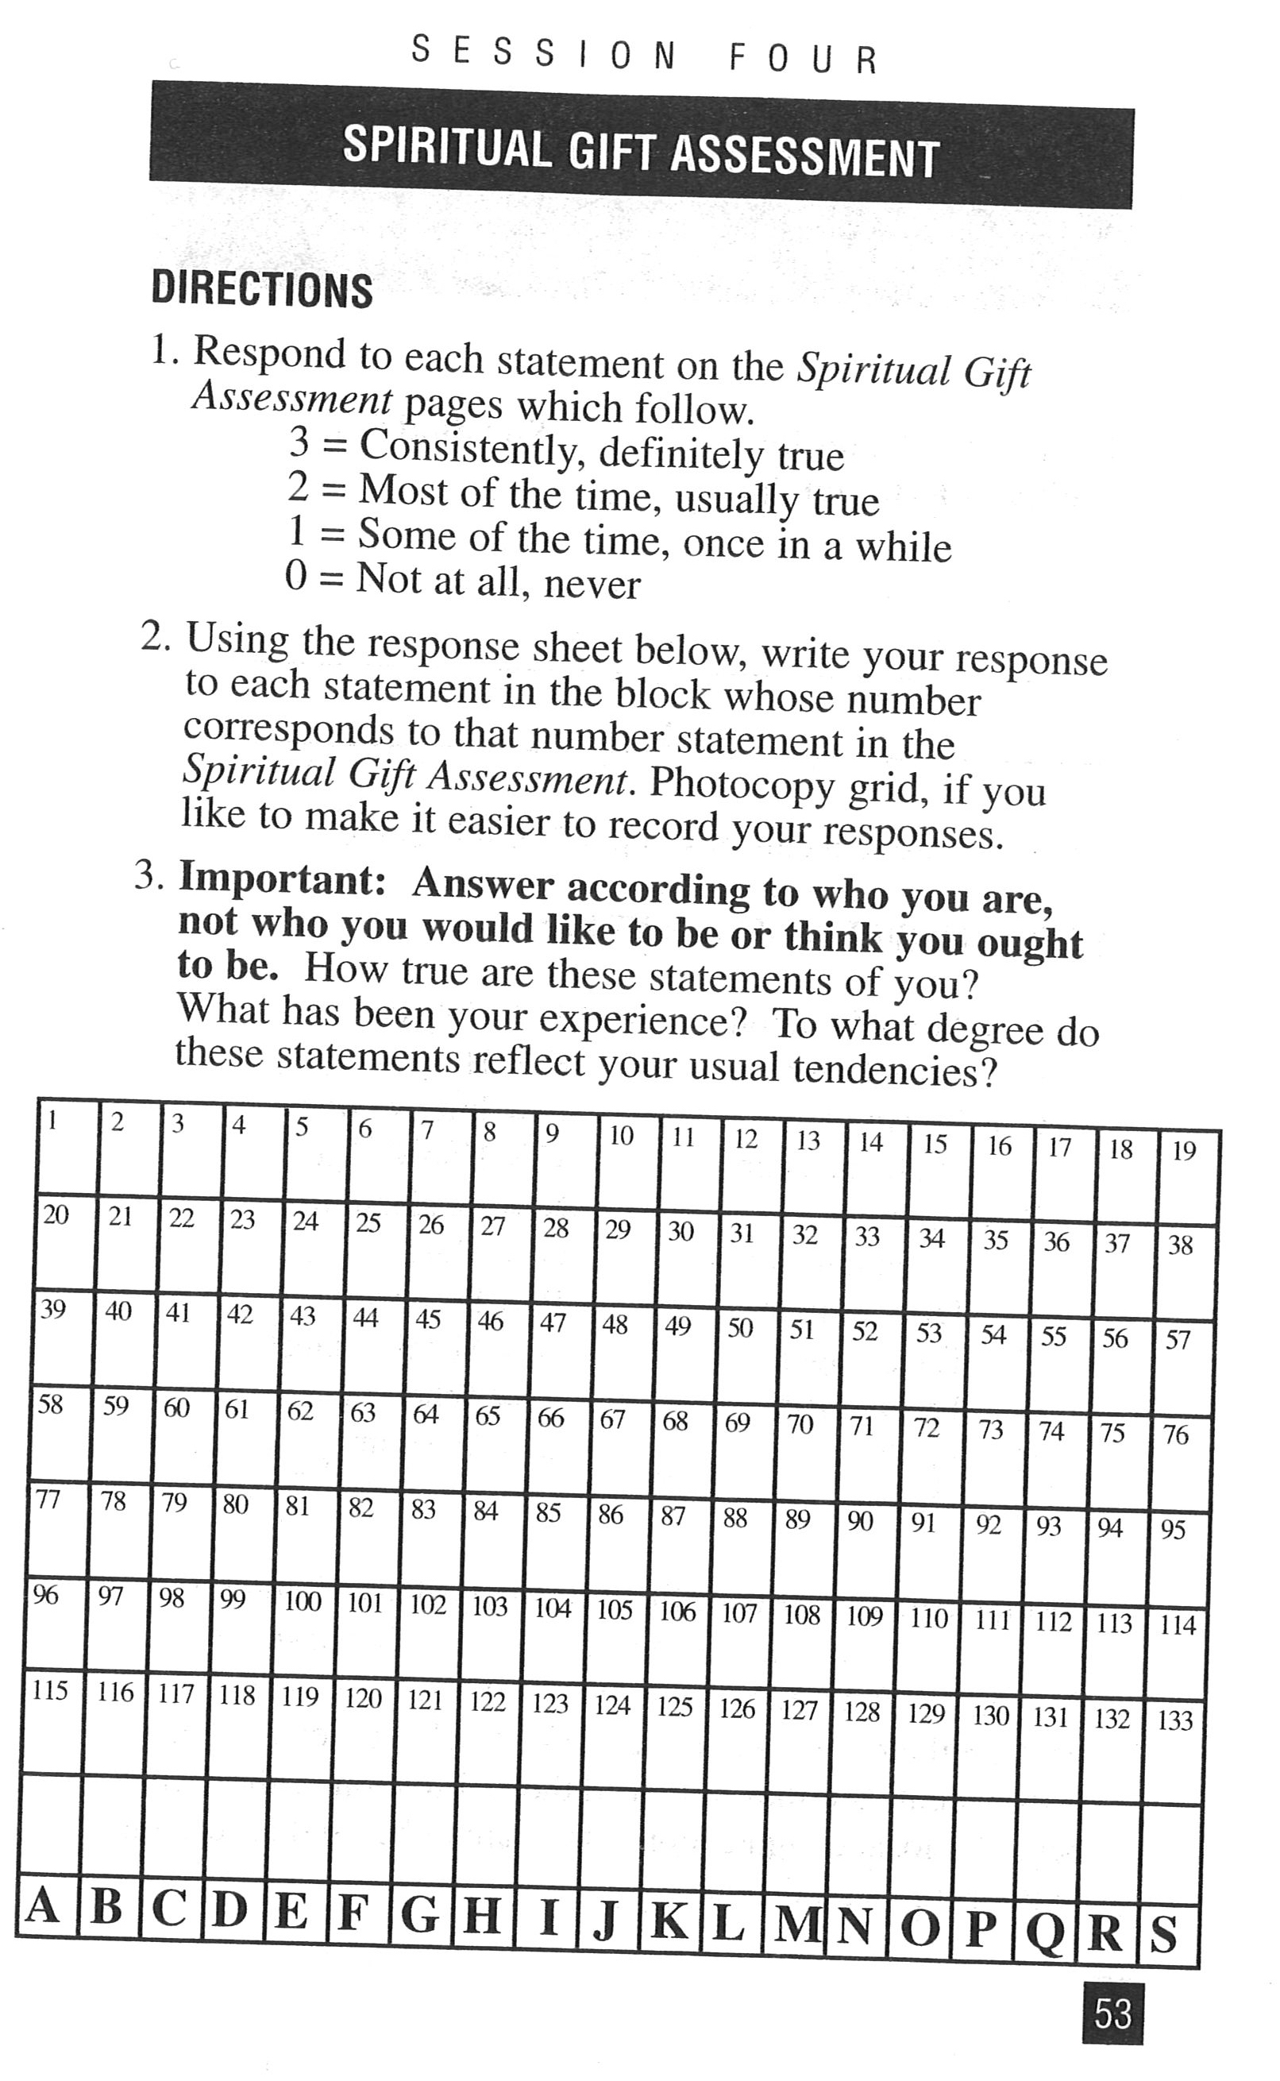

Slide 39
Step 4: Seek Feedback
Philippians 2:3 “It is God who is at work within you, enabling you both to will and to work for His good pleasure.”
Experimenting will tell you which gifts you have and which ones you don’t have
Your honest feelings are one way to determine if you have a gift
Affirmation from church members is another source of feedback

Slide 40
Review of the Four Steps
Step 1: Be Open to Possibilities
Step 2: Examine Your Feelings
Step 3: Experiment With the Gifts
Step 4: Seek Feedback

Slide 41
1 Corinthians 12:4-7
⁴ Now there are varieties of gifts, but the same Spirit; ⁵ and there are varieties of services, but the same Lord; ⁶ and there are varieties of activities, but it is the same God who activates all of them in everyone. ⁷ To each is given the manifestation of the Spirit for the common good.

